Slide 1

College of Technology (01)
Silver Oak College of Engineering and Technology
Bachelor of Technology
Department of Information Technology (010)
FAKE NEWS DETECTOR USING PYTHON
Deep Vaghasiya Prof. Swati Koshti

Slide 2
Table of Content
Abstract
Introduction
Literature Survey/Research
Study of Current System
Problems/Weakness/Improvement needed in Current System
Features of Proposed System
Tools and Technologies used
Worked carried out till date
Future Work & Conclusion
Timeline Chart
References

Slide 3
Abstract
In an era of information overload and digital media, the spread of fake news poses a significant challenge to reliable information dissemination. The "Fake News Detector" project leverages the power of Python to develop a sophisticated system capable of identifying and flagging potentially deceptive news articles. By employing natural language processing (NLP) techniques, the system analyzes textual content, examines linguistic patterns, and assesses the credibility of sources to distinguish between genuine and fabricated news. Through the integration of machine learning algorithms, the detector learns from a labeled dataset, enhancing its accuracy over time. This project contributes to the ongoing battle against misinformation, aiding users in making informed decisions while consuming news in the digital age.

Slide 4

Introduction
The project aims to develop an intelligent system that can automatically analyze and classify news articles as either genuine or fake. Leveraging Python's robust libraries and tools. By analyzing the linguistic features, writing style, tone, and source credibility, the system endeavors to differentiate between trustworthy news and deceptive narratives.
NLP techniques empower the system to delve deep into the textual structure, identifying anomalies and patterns that are indicative of misinformation. Through the utilization of labeled datasets and machine learning models, the detector learns from historical examples, continuously improving its accuracy and adaptability.

Slide 5
Our finally selected and best performing classifier was Logistic Regression
Our finally selected and best performing classifier was Logistic Regression
Our finally selected and best performing classifier was Logistic Regression
Literature Survey/Research
There are several algorithms for detecting the fake news. For that we analyse through different classifiers in different research papers.
We have used Naive-bayes, Logistic Regression, Linear SVM, Stochastic gradient descent and Random forest classifiers from sklearn.
Once fitting the model, we compared the f1 score and checked the confusion matrix. After fitting all the classifiers, 2 best performing models were selected as candidate models for fake news classification.
Our finally selected and best performing classifier was Logistic Regression which is used for fake news detection with the probability of truth.

Slide 6

Tools & Technologies used
Python: Python is the primary programming language used for implementing the fake news detection system.
Natural Language Processing (NLP) Libraries: NLTK (Natural Language Toolkit) - NLTK provides tools for working with human language data and includes various modules for text preprocessing, tokenization, stemming, and more.
Machine Learning Libraries: Scikit-learn - This library offers a wide range of machine learning algorithms and tools for classification, regression, and model evaluation.
Text Vectorization and Embeddings: TF-IDF (Term Frequency-Inverse Document Frequency) - A technique for transforming text into numerical vectors based on term frequencies and inverse document frequencies.
Web Scraping Libraries: Beautiful Soup - A Python library for web scraping, allowing you to extract textual content from online news articles and sources.
Datasets: The data source used for this project is LIAR dataset which contains 3 files with .tsv format for test, train and validation.
7) Version Control & Source Control: Git & GitHub
8) IDE (Integrated Development Environment): I have used Visual Studio Code and Jupyter Notebook.
9) Visualization Libraries: Matplotlib and Seaborn - These libraries help in creating visualizations to analyze data and present results effectively.

Slide 7
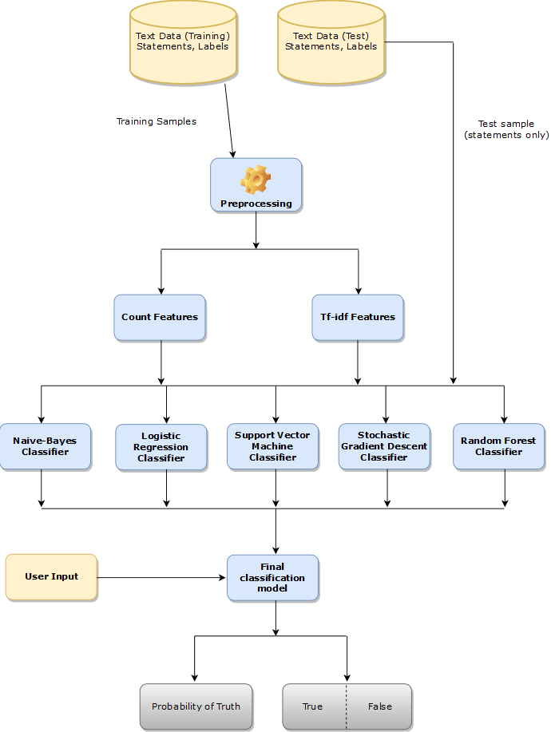
Process Flow

Slide 8


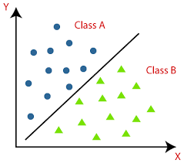
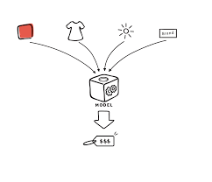
Worked carried out till date
1) Data Preparations : This file contains all the pre processing functions needed to process all input documents and texts. First we read the train, test and validation data. There are some exploratory data analysis is performed like response variable distribution and data quality checks like null or missing values etc.
2) Feature Selection : Feature extraction and selection methods from sci-kit learn python libraries. For feature selection, we have used methods like simple bag-of-words and n-grams and then term frequency like tf-tdf weighting.
3) Classification : We have used Naive-bayes, Logistic Regression, Linear SVM, Stochastic gradient descent and Random forest classifiers from sklearn.
4) Prediction : Our finally selected and best performing classifier was Logistic Regression with the accuracy of 97%.

Slide 9
Future Work & Conclusion
Future Work
Conclusion
Enhanced Feature Engineering: Investigate additional linguistic, semantic, or contextual features that could improve the accuracy of your detection model. For example, exploring advanced sentiment analysis or more sophisticated stylistic features.
Dynamic Adaptation: Create a system that can adapt to the evolving techniques used by fake news generators. Regularly updating the model with fresh data and techniques could improve its ability to detect new forms of misinformation.
Multilingual Support: Extend the project's capabilities to handle multiple languages, allowing it to detect fake news across diverse linguistic contexts.
The primary purpose of our fake news detection project was to develop a robust and accurate system capable of distinguishing between genuine news articles and fabricated content. The project aimed to leverage the power of natural language processing (NLP) and machine learning to analyze textual data, identify linguistic patterns, and assess the credibility of sources. By implementing this system, our goal was to contribute to the fight against misinformation by providing users with a reliable tool to make informed decisions while consuming news in the digital era. Through the integration of various techniques and methodologies, we sought to create a solution and helps combat the harmful effects of fake news on society.

Slide 10
Time Line Chart
Project Inception : 1 Day
Research and planning : 2 Days
Data Collection and Preprocessing : 2 Days
Feature Engineering and Model selection : 5 Days

Slide 11
References
https://ijcrt.org/papers/IJCRT2201553.pdf
https://sist.sathyabama.ac.in/sist_naac/documents/1.3.4/b.e-cse-batchno-214.pdf
https://data-flair.training/blogs/advanced-python-project-detecting-fake-news/

Slide 12
Thank You..!
Any Questions?

